Slide 1
K-means. Clustering Goodness.
Soft K-means. Gaussian Mixture Models.
Kernel K-means.
Radu Ionescu, Prof. PhD.
raducu.ionescu@gmail.com
Faculty of Mathematics and Computer Science
University of Bucharest

Slide 2
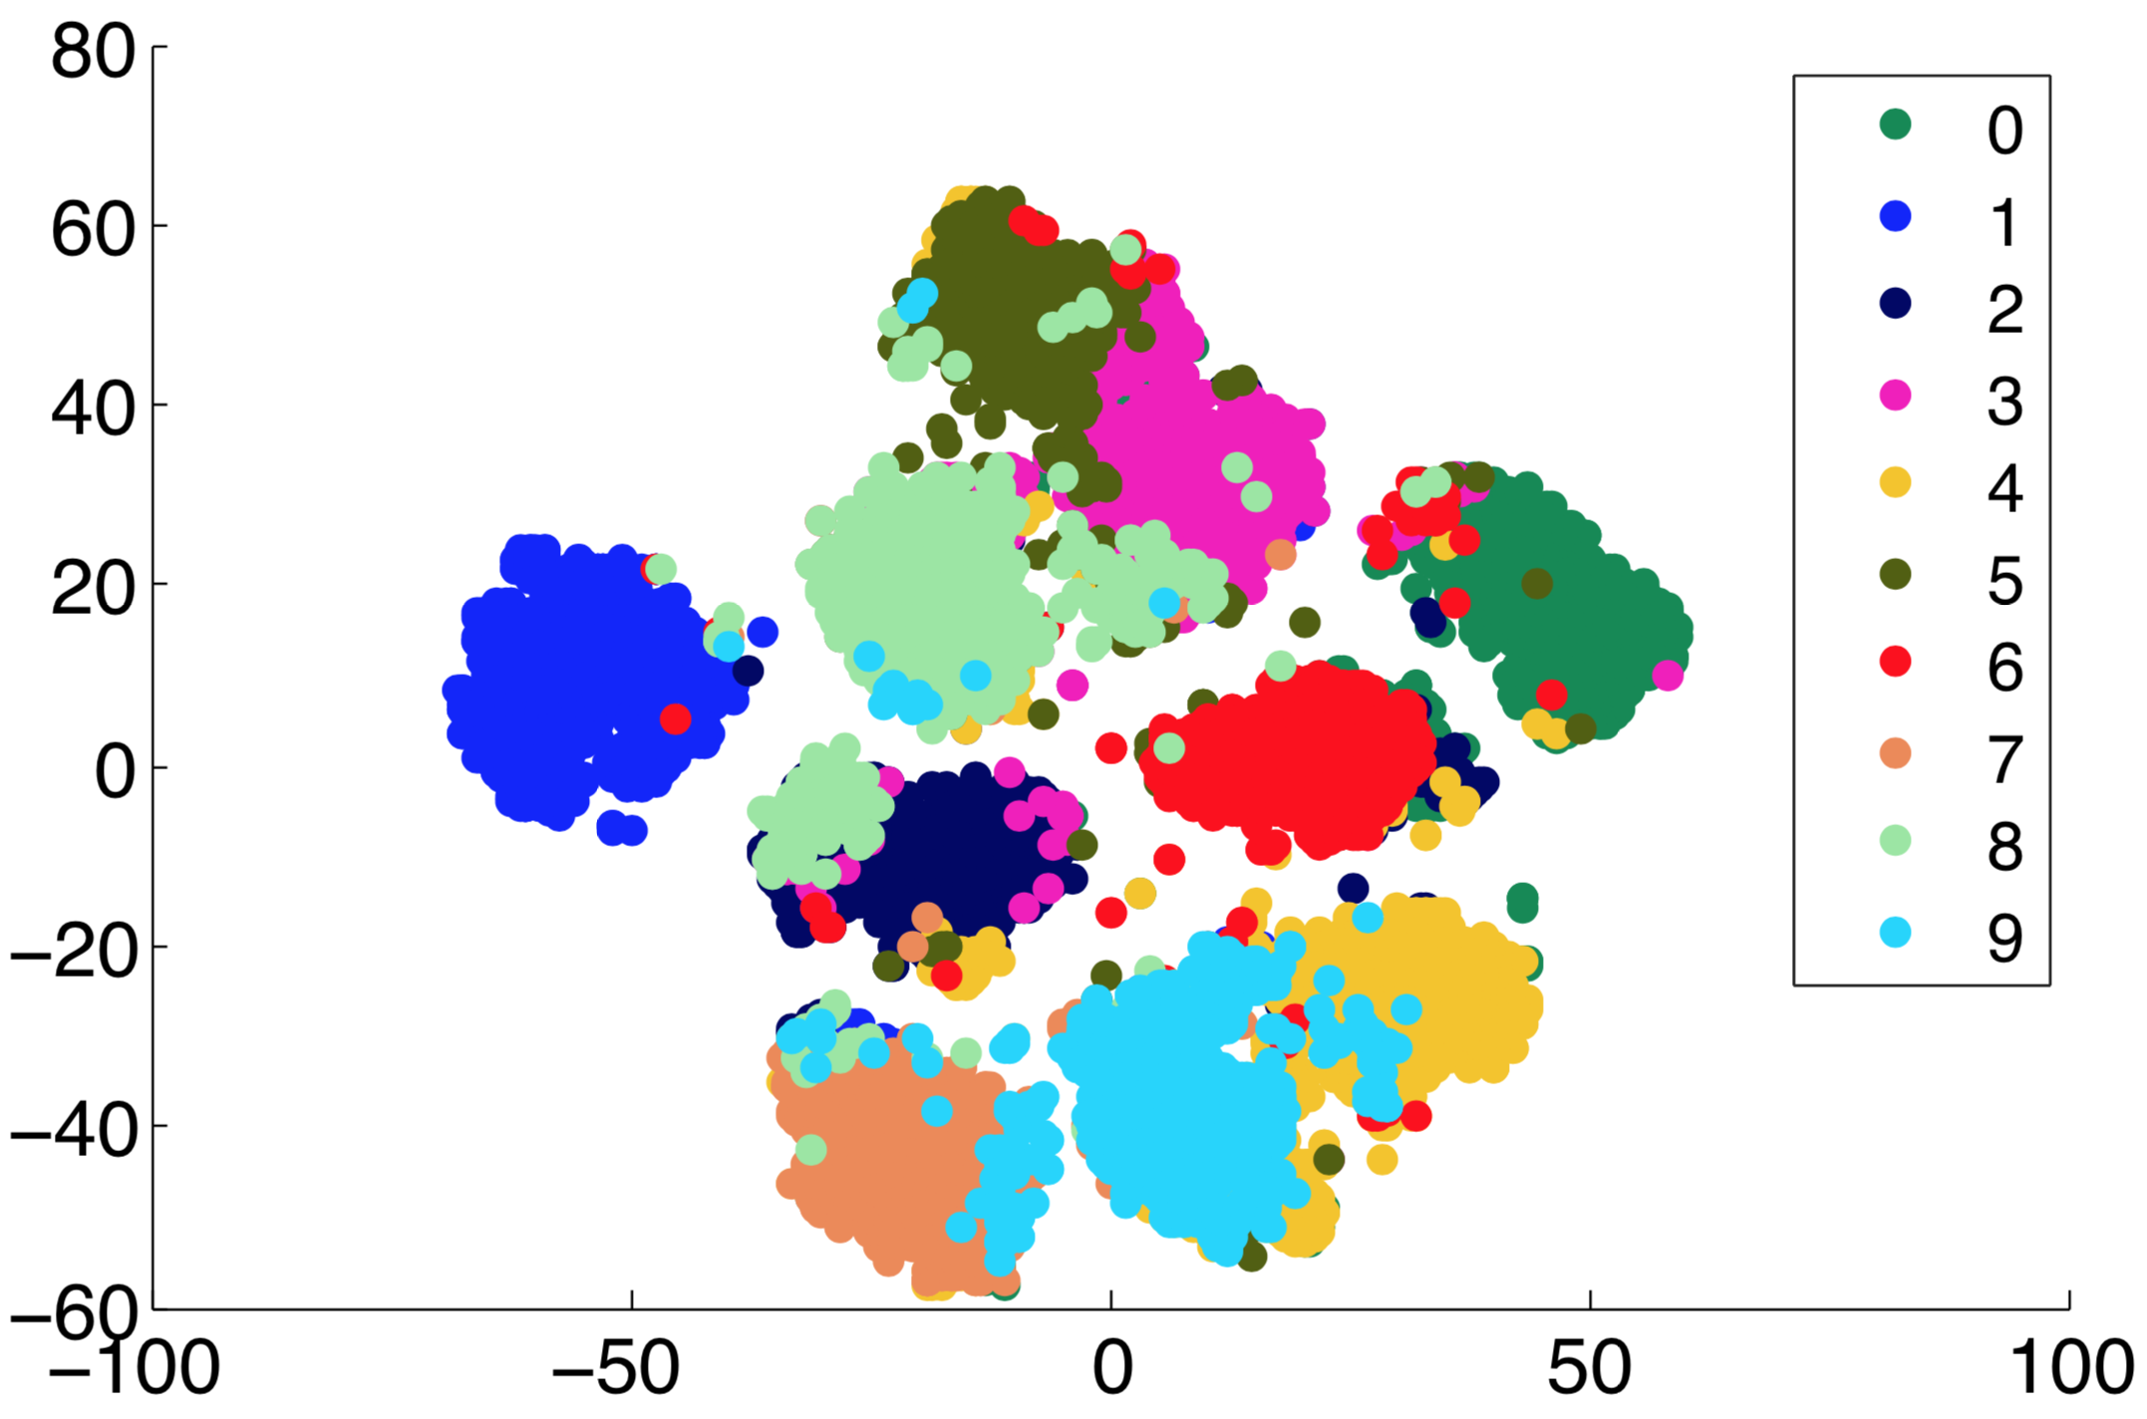
Reminder: Unsupervised Learning
There are no labels for the training phase
Our goal is to discover structure in data

Slide 3
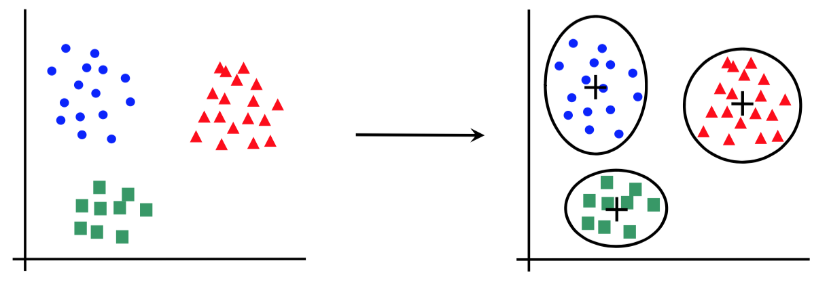
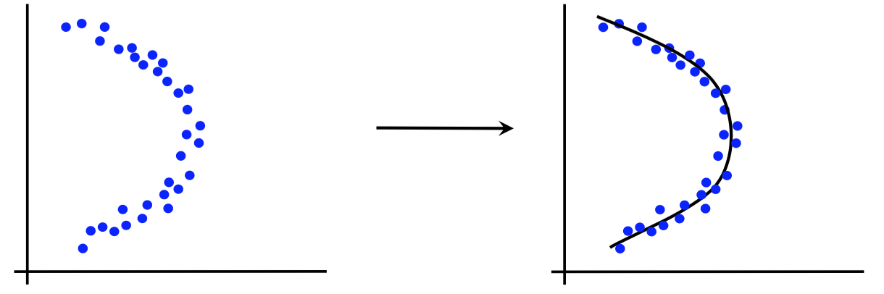
Canonical forms of unsupervised learning problems
Clustering
Dimensionality Reduction
K-means
DBSCAN
Hierarchical Clustering
…
Principal Component Analysis
t-SNE
…

Slide 4
Clustering
Clustering or Cluster Analysis is the task of grouping a set of objects such that objects in the same group (cluster) are more similar to each other than to objects in other groups
There are several types of clustering methods:
Centroid-based: each cluster is represented by a prototype object (a center), e.g. k-means
Density-based: clusters are dense regions of space, e.g. DBSCAN
Distribution-based: clusters are modeled by statistical distributions, e.g. GMM
Graph-based: clusters are cliques in a graph, e.g. HCS
Hierarchical models: there is a hierarchical relationship between clusters
Based on the relation between objects and clusters:
Hard-clustering (partitioning): one object can belong to a single cluster
Soft-clustering (fuzzy-clustering): each object has a degree of membership to each cluster
Notes:
HCS (Highly Connected Subgraphs) clustering algorithm

Slide 5
K-means

Slide 6
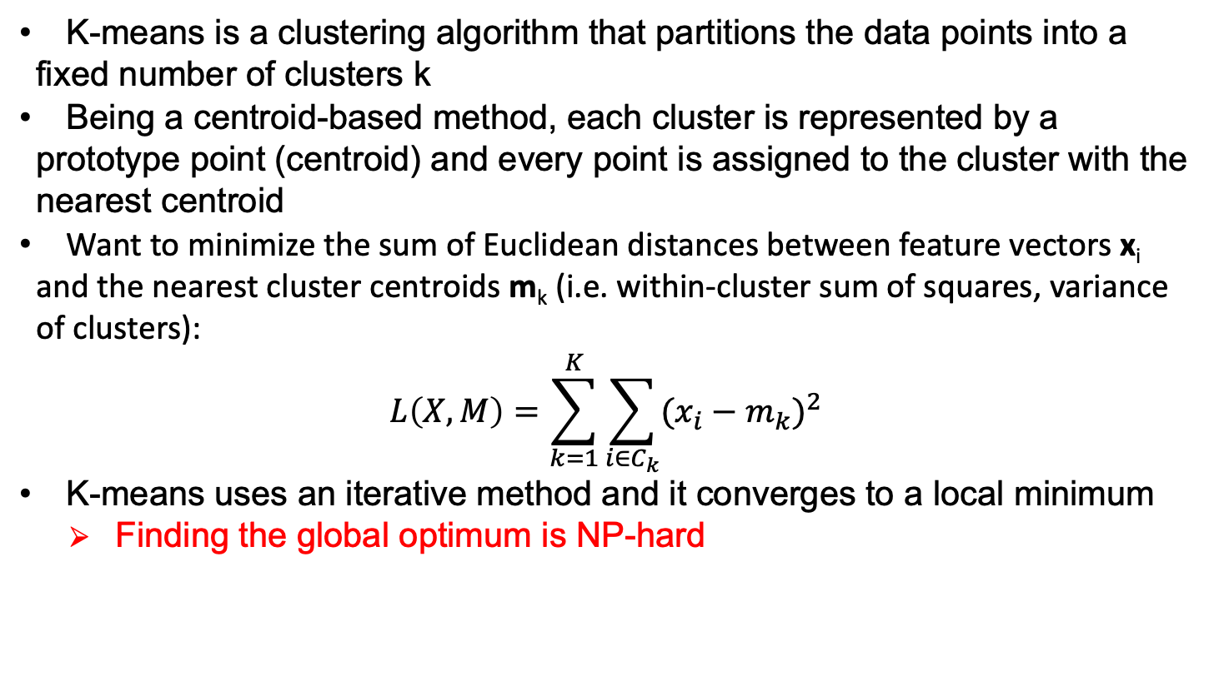
K-means
K-means is a clustering algorithm that partitions the data points into a fixed number of clusters k
Being a centroid-based method, each cluster is represented by a prototype point (centroid) and every point is assigned to the cluster with the nearest centroid
Want to minimize the sum of Euclidean distances between feature vectors x_{i} and the nearest cluster centroids m_{k} (i.e. within-cluster sum of squares, variance of clusters):
$$L\left(X,M\right)=\sum_{k=1}^{K}{\sum_{{i∈C}_{k}}{{(x_{i}−m_{k})}^{2}}}$$
K-means uses an iterative method and it converges to a local minimum
Finding the global optimum is NP-hard

Slide 7
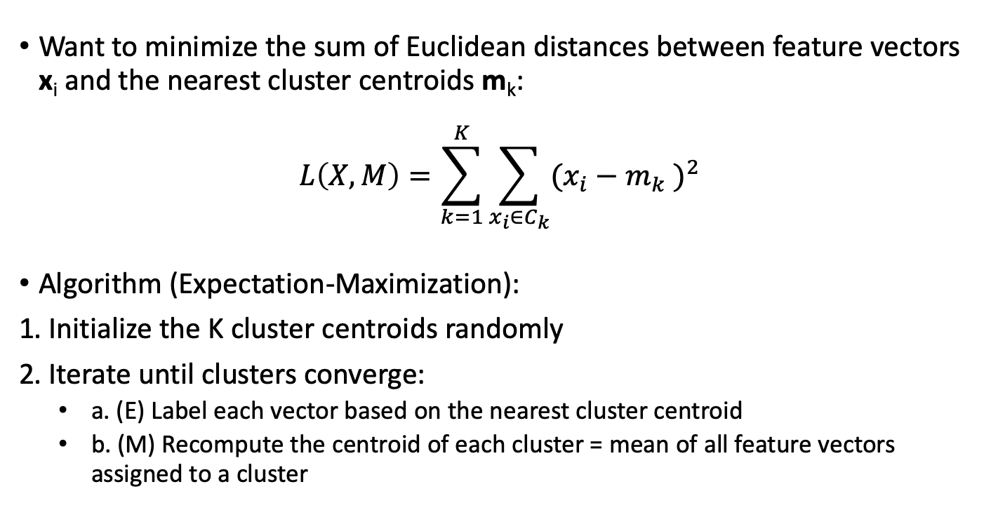
K-means clustering
Want to minimize the sum of Euclidean distances between feature vectors x_{i} and the nearest cluster centroids m_{k}:
$$L\left(X,M\right)=\sum_{k=1}^{K}{\sum_{{x_{i}∈C}_{k}}{{(x_{i}−m_{k} )}^{2}}}$$
Algorithm (Expectation-Maximization):
1. Initialize the K cluster centroids randomly
2. Iterate until clusters converge:
a. (E) Label each vector based on the nearest cluster centroid
b. (M) Recompute the centroid of each cluster = mean of all feature vectors assigned to a cluster

Slide 8
K-means clustering – 1.

Slide 9
K-means clustering – 1.

Slide 10
K-means clustering – 2.a.

Slide 11
K-means clustering – 2.b.

Slide 12
K-means clustering – 2.b.

Slide 13
K-means clustering – 2.a.

Slide 14
K-means clustering – 2.b.

Slide 15
K-means clustering – 2.b.

Slide 16
K-means clustering – 2.a.

Slide 17
K-means clustering – 2.b.

Slide 18
K-means clustering – 2.b.

Slide 19
K-means clustering – 2.a.

Slide 20
K-means clustering – 2.b.

Slide 21
K-means clustering – 2.b.

Slide 22
K-means clustering – 2.a.

Slide 23
K-means clustering - Output

Slide 24
K-means clustering – Output?
A Voronoi tessellation!

Slide 25
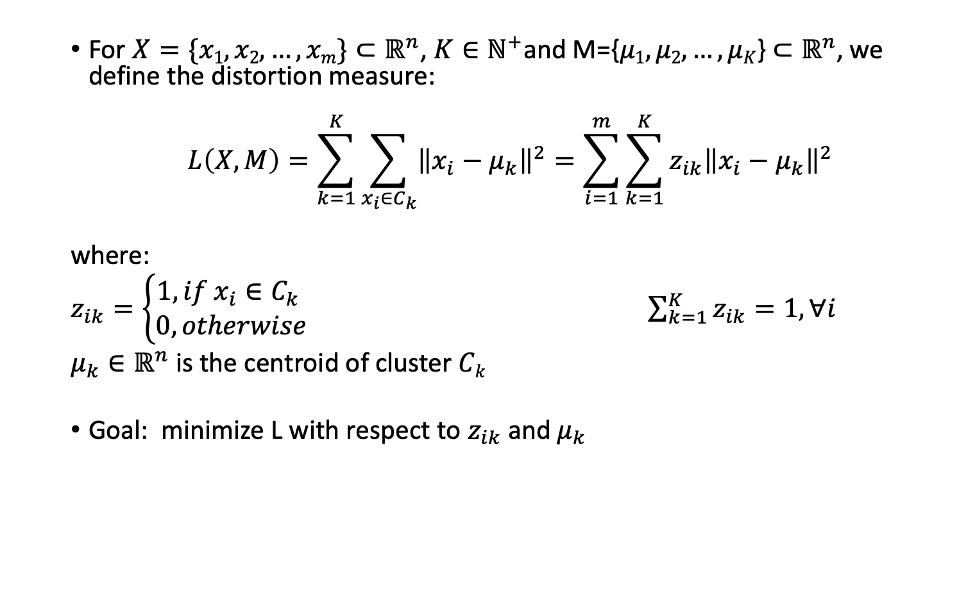
Mathematical formulation
For $X=\{x1, x2,…, xm\}⊂ℝ^{n}$, $K∈ℕ^{+}$and M={$μ1, μ2,…, μK$} $⊂ℝ^{n}$, we define the distortion measure:
$$L\left(X,M\right)=\sum_{k=1}^{K}{\sum_{{x_{i}∈C}_{k}}{{\left\|x_{i}−μ_{k}\right\|}^{2}}}=\sum_{i=1}^{m}{\sum_{k=1}^{K}{{z_{ik}\left\|x_{i}−μ_{k}\right\|}^{2}}}$$
where:
$z_{ik}=\left\{\begin{matrix}1, if {x_{i}∈C}_{k} \\ 0, otherwise\end{matrix}\right.$ $\sum_{k=1}^{K}{z_{ik}}=1,∀i$
$μ_{k}∈ℝ^{n}$ is the centroid of cluster $Ck$
Goal: minimize L with respect to $z_{ik}$and $μ_{k}$
Hard-clustering (partition)

Slide 26
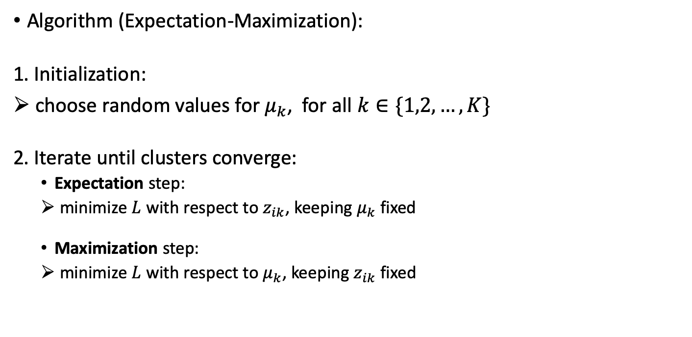
K-means algorithm: in depth
Algorithm (Expectation-Maximization):
1. Initialization:
choose random values for $μ_{k}$, for all $k∈\{1,2,…,K\}$
2. Iterate until clusters converge:
Expectation step:
minimize $L$ with respect to $z_{ik}$, keeping $μ_{k}$fixed
Maximization step:
minimize $L$ with respect to $μ_{k}$, keeping $z_{ik}$ fixed

Slide 27
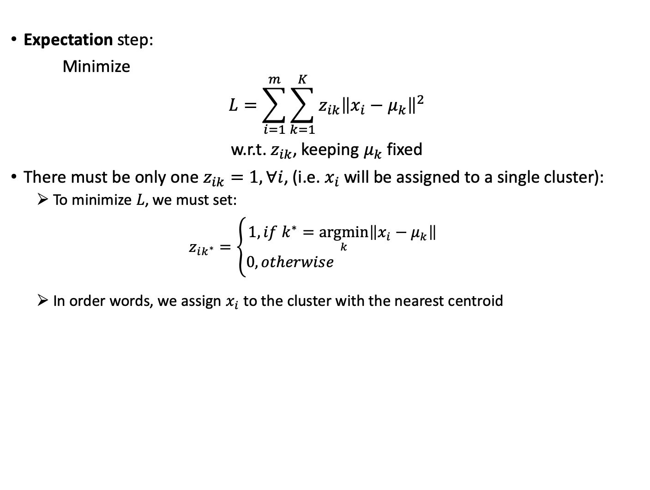
K-means algorithm: in depth
Expectation step:
Minimize
$$L=\sum_{i=1}^{m}{\sum_{k=1}^{K}{{z_{ik}\left\|x_{i}−μ_{k}\right\|}^{2}}}$$
w.r.t. $z_{ik}$, keeping $μ_{k}$fixed
There must be only one $z_{ik}=1, ∀i$, (i.e. $x_{i}$will be assigned to a single cluster):
To minimize $L$, we must set:
$$z_{ik^{∗}}=\left\{\begin{matrix}1, if{ k}^{∗}=\underset{k}{argmin}\left\|x_{i}−μ_{k}\right\| \\ 0, otherwise \end{matrix}\right.$$
In order words, we assign $x_{i}$ to the cluster with the nearest centroid

Slide 28
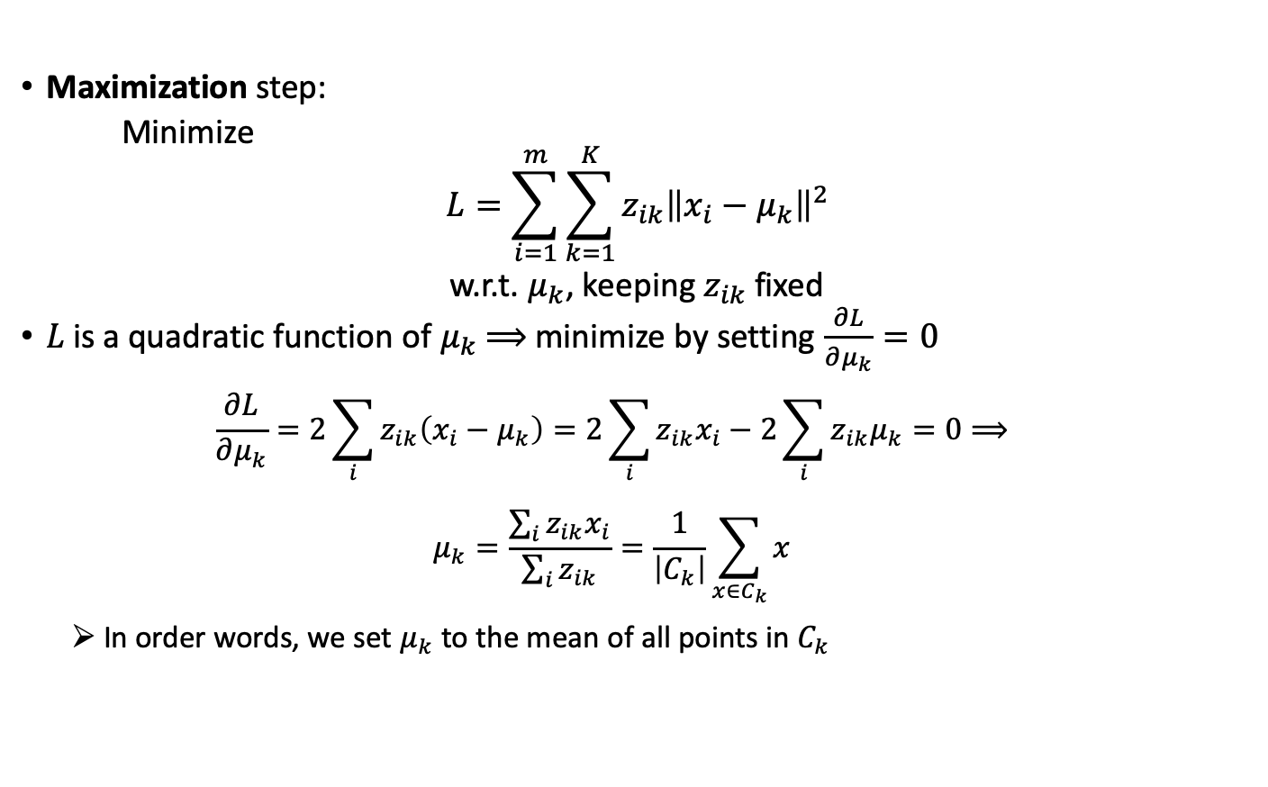
K-means algorithm: in depth
Maximization step:
Minimize
$$L=\sum_{i=1}^{m}{\sum_{k=1}^{K}{{z_{ik}\left\|x_{i}−μ_{k}\right\|}^{2}}}$$
w.r.t. $μ_{k}$, keeping $z_{ik}$ fixed
$L$is a quadratic function of $μ_{k}$ $⟹$ minimize by setting $\frac{∂L}{∂μ_{k}}=0$
$$\frac{∂L}{∂μ_{k}}=2\sum_{i}{z_{ik}\left(x_{i}−μ_{k}\right)}=2\sum_{i}{z_{ik}x_{i}}−2\sum_{i}{z_{ik}μ_{k}}=0⟹$$
$$μ_{k}=\frac{\sum_{i}{z_{ik}x_{i}}}{\sum_{i}{z_{ik}}}=\frac{1}{\left|C_{k}\right|}\sum_{x∈C_{k}}{x}$$
In order words, we set${ μ}_{k}$ to the mean of all points in $C_{k}$

Slide 29
Parameters and Evaluation

Slide 30
How to choose k?
The number of clusters k is a hyperparameter. How do we find a good k?
1. Elbow method:
Start with a small k value and increase it until adding another cluster does not result in a much lower distortion value
In other words, the new cluster does not explain so much the variance in data
2. Silhouette Coefficient:
A measure of how tight each cluster is and how far apart clusters are from each other
Choose a value of k that results in clustering with a large silhouette coefficient

Slide 31








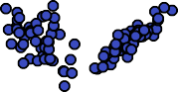
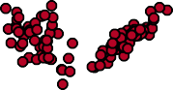
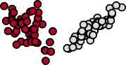
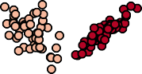
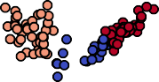
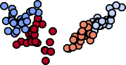
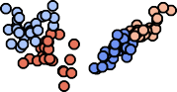
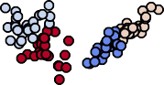

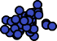



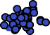
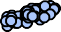


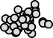



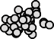

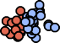
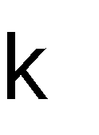
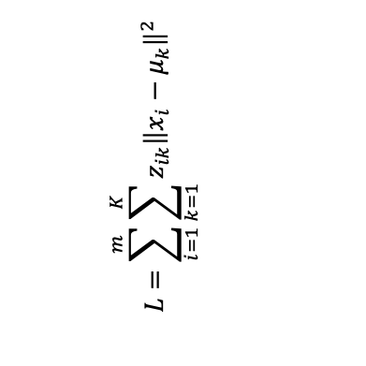
The Elbow Method
Choose k such that adding another cluster will not explain the variance in data by much (i.e. does not give a much lower distortion value)
$$L=\sum_{i=1}^{m}{\sum_{k=1}^{K}{{z_{ik}\left\|x_{i}−μ_{k}\right\|}^{2}}}$$

Slide 32
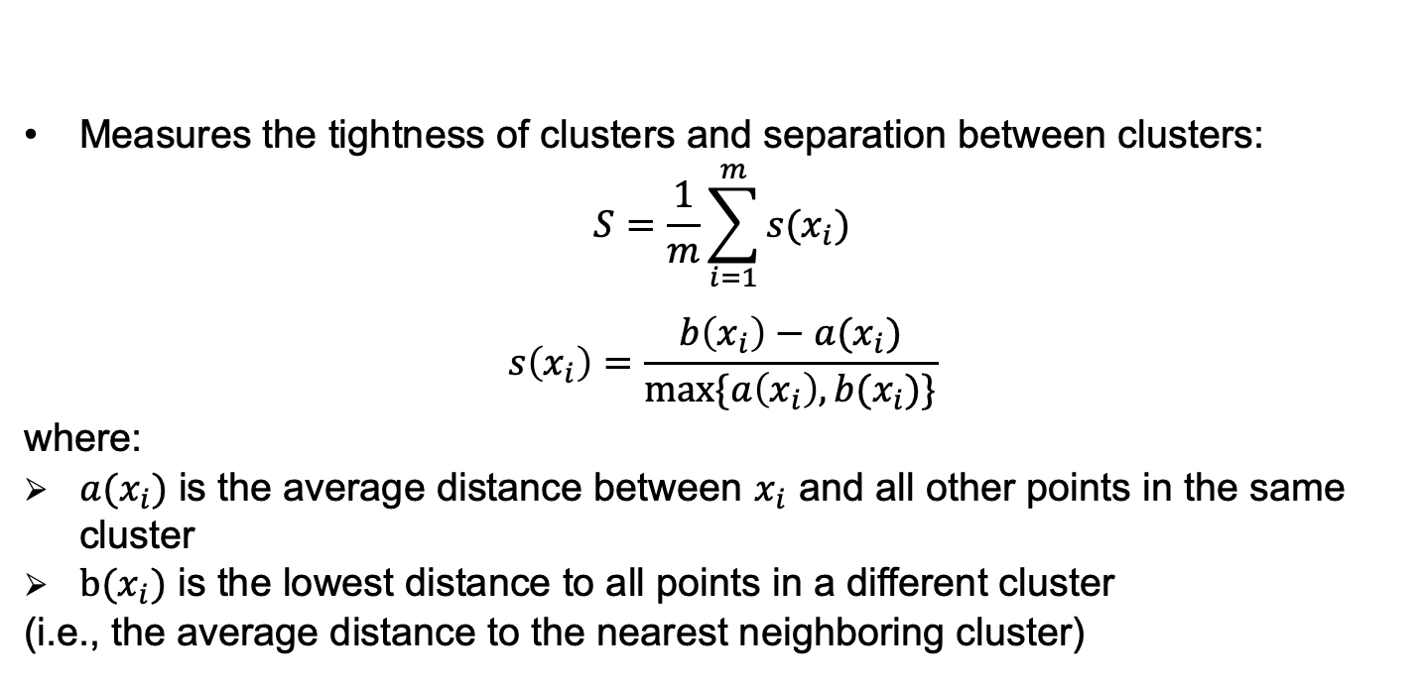
The Silhouette Coefficient
Measures the tightness of clusters and separation between clusters:
$$S=\frac{1}{m}\sum_{i=1}^{m}{s(x_{i})}$$
$$s\left(x_{i}\right)=\frac{b\left(x_{i}\right)−a(x_{i})}{\max{\{a\left(x_{i}\right),b(x_{i})\}}}$$
where:
${a(x}_{i})$ is the average distance between $x_{i}$ and all other points in the same cluster
$b(x_{i})$ is the lowest distance to all points in a different cluster
(i.e., the average distance to the nearest neighboring cluster)

Slide 33








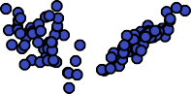
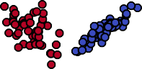
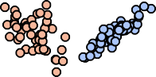
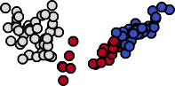
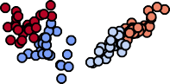
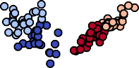
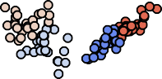


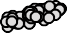
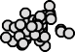



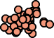

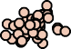



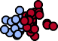
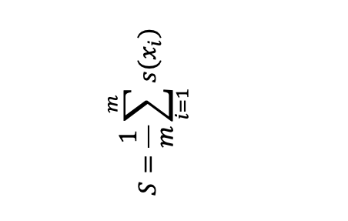
The Silhouette Coefficient
Choose k that gives the highest mean silhouette
$$S=\frac{1}{m}\sum_{i=1}^{m}{s(x_{i})}$$

Slide 34
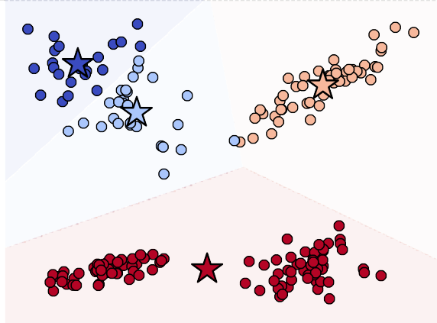
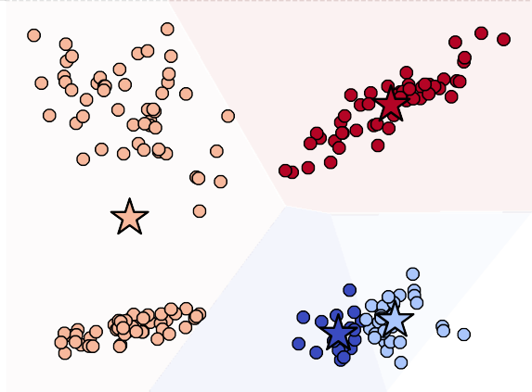
Local Minima
K-means converges to local minima
Both of the following states are stable (more iterations will not change the clustering)
Possible solutions:
Run the algorithm multiple times and choose the result with lowest distortion
(or highest silhouette)
Use a better initialization method

Slide 35

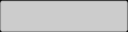






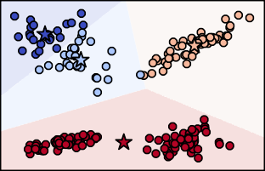
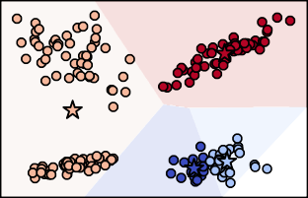
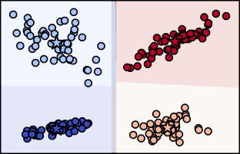
Local Minima
Run the algorithm multiple times and choose the result with lowest distortion
(or highest silhouette)

Slide 36
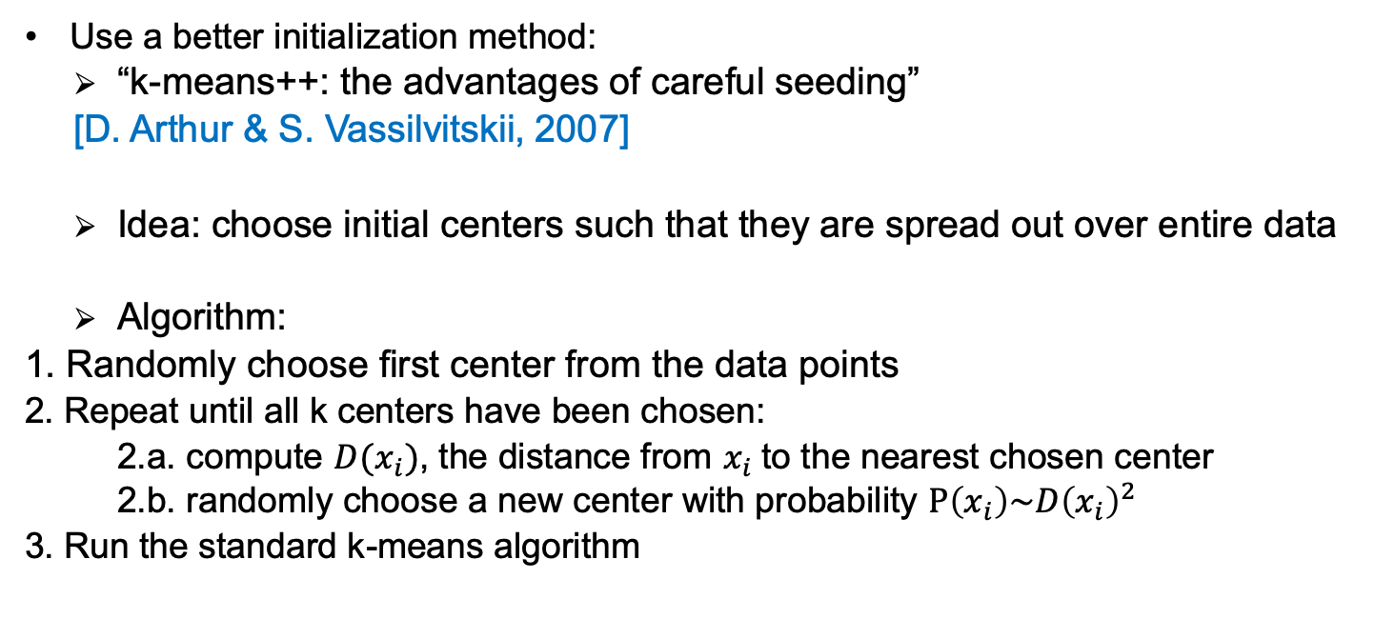
K-means++ initializaiton
Use a better initialization method:
“k-means++: the advantages of careful seeding”
[D. Arthur & S. Vassilvitskii, 2007]
Idea: choose initial centers such that they are spread out over entire data
Algorithm:
1. Randomly choose first center from the data points
2. Repeat until all k centers have been chosen:
2.a. compute $D(x_{i})$, the distance from $x_{i}$to the nearest chosen center
2.b. randomly choose a new center with probability $P\left(x_{i}\right)\sim {D\left(x_{i}\right)}^{2}$
3. Run the standard k-means algorithm

Slide 37
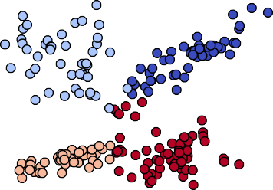
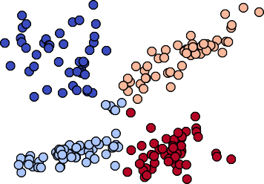
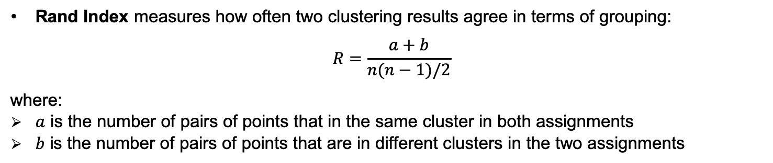
Comparing results
How similar are these two clustering results?
The actual label assigned to each cluster is not important, only the grouping of points matters
Rand Index measures how often two clustering results agree in terms of grouping:
$$R=\frac{a+b}{n(n−1)/2}$$
where:
$a$ is the number of pairs of points that in the same cluster in both assignments
$b$ is the number of pairs of points that are in different clusters in the two assignments
Adjusted Rand Index is another measure that takes into account that results might agree by chance

Slide 38
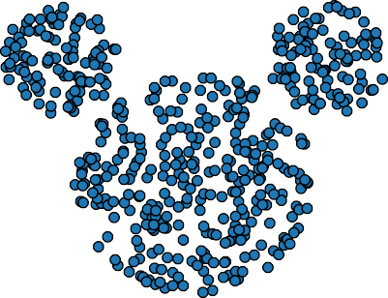



Limitations of K-means
How will k-means handle these data sets?

Slide 39




Limitations of K-means
How will k-means handle these data sets?
Not so good…
K-means only produces convex clusters
It does not handle non-spherical clusters too well
It tends to produce clusters of equal size

Slide 40
K-means Variations

Slide 41


Soft K-means
Recall K-means Expectation step: $z_{ik^{∗}}=\left\{\begin{matrix}1, if{ k}^{∗}=\underset{k}{argmin}\left\|x_{i}−μ_{k}\right\| \\ 0, otherwise \end{matrix}\right.$
It will produce a partitioning (hard-clustering), i.e. a point belongs to one and only one cluster
Sometimes, in practice, clusters might have overlapping regions, and there is no clear boundary between clusters

Slide 42


Soft K-means
Recall K-means Expectation step: $z_{ik^{∗}}=\left\{\begin{matrix}1, if{ k}^{∗}=\underset{k}{argmin}\left\|x_{i}−μ_{k}\right\| \\ 0, otherwise \end{matrix}\right.$
It will produce a partitioning (hard-clustering), i.e. a point belongs to one and only one cluster
Sometimes, in practice, clusters might have overlapping regions, and there is no clear boundary between clusters
With hard-clustering, the assignment in such regions will likely be caused by chance from random initialization

Slide 43





Soft K-means
Recall K-means Expectation step: $z_{ik^{∗}}=\left\{\begin{matrix}1, if{ k}^{∗}=\underset{k}{argmin}\left\|x_{i}−μ_{k}\right\| \\ 0, otherwise \end{matrix}\right.$
It will produce a partitioning (hard-clustering), i.e. a point belongs to one and only one cluster
Sometimes, in practice, clusters might have overlapping regions, and there is no clear boundary between clusters
With hard-clustering, the assignment in such regions will likely be caused by chance from random initialization
Soft K-means redefines the Expectation step such that
$z_{ik}∈ℝ$ is the degree of membership of $x_{i}$ to cluster $C_{k}$
$$z_{ik^{∗}}=\frac{e^{−β\left\|x_{i}−μ_{k^{∗}}\right\|}}{\sum_{k}{e^{−β\left\|x_{i}−μ_{k}\right\|}}}$$
$$μ_{k}=\frac{\sum_{i}{z_{ik}x_{i}}}{\sum_{i}{z_{ik}}}$$
Expectation
Maximization
Points in this area have ~0.5 membership in both clusters

Slide 44


Soft K-means
Soft K-means does not solve issues of unequally-sized and non-spherical clusters

Slide 45






Gaussian Mixture Models
GMMs are probabilistic models that assume that data points are generated by a mixture of normal distributions, i.e. Gaussians
An EM algorithm can be used to fit the Gaussians by maximizing the likelihood of data

Slide 46








































Gaussian Mixture Models
GMMs are probabilistic models that assume that data points are generated by a mixture of normal distributions, i.e. Gaussians
An EM algorithm can be used to fit the Gaussians by maximizing the likelihood of data
GMMs can be viewed as an extension of soft K-means in which each cluster has both a mean and a covariance matrix (that gives the non-spherical shape)

Slide 47
Kernel K-means

Slide 48



Removing centroids from the equation
Expectation step means setting: $z_{ik^{∗}}=\left\{\begin{matrix}1, if{ k}^{∗}=\underset{k}{argmin}\left\|x_{i}−μ_{k}\right\| \\ 0, otherwise \end{matrix}\right.$
$\left\|x_{i}−μ_{k}\right\|=\sqrt{\left\langle x_{i}−μ_{k},x_{i}−μ_{k}\right\rangle }$
$$=\sqrt{\left\langle x_{i},x_{i}\right\rangle −2\left\langle x_{i},μ_{k}\right\rangle +\left\langle μ_{k},μ_{k}\right\rangle }$$
Norm of a vector is the square root of the dot product with itself
Dot product is distributive

Slide 49


Removing centroids from the equation
Expectation step means setting: $z_{ik^{∗}}=\left\{\begin{matrix}1, if{ k}^{∗}=\underset{k}{argmin}\left\|x_{i}−μ_{k}\right\| \\ 0, otherwise \end{matrix}\right.$
$$\left\|x_{i}−μ_{k}\right\|=\sqrt{\left\langle x_{i}−μ_{k},x_{i}−μ_{k}\right\rangle }=\sqrt{\left\langle x_{i},x_{i}\right\rangle −2\left\langle x_{i},μ_{k}\right\rangle +\left\langle μ_{k},μ_{k}\right\rangle }$$
$$=\sqrt{{\left\|x_{i}\right\|}^{2}−2\left\langle x_{i},\frac{1}{\left|C_{k}\right|}\sum_{s∈C_{k}}{s}\right\rangle +\left\langle \frac{1}{\left|C_{k}\right|}\sum_{s∈C_{k}}{s},\frac{1}{\left|C_{k}\right|}\sum_{t∈C_{k}}{t}\right\rangle }$$
$=\sqrt{{\left\|x_{i}\right\|}^{2}−2\frac{1}{\left|C_{k}\right|}\sum_{s∈C_{k}}{\left\langle x_{i},s\right\rangle }+\frac{1}{{\left|C_{k}\right|}^{2}}\sum_{s∈C_{k}}{\sum_{t∈C_{k}}{\left\langle s,t\right\rangle }}}$
$$\underset{k}{argmin}\left\|x_{i}−μ_{k}\right\|=\underset{k}{argmin}\left(−2\frac{1}{\left|C_{k}\right|}\sum_{s∈C_{k}}{\left\langle x_{i},s\right\rangle }+\frac{1}{{\left|C_{k}\right|}^{2}}\sum_{s∈C_{k}}{\sum_{t∈C_{k}}{\left\langle s,t\right\rangle }}\right)$$
Dot product is distributive
${\left\|x_{i}\right\|}^{2}$ and $√$ do not affect argmin
We can do k-means clustering without computing the centroids
The expression depends only on the dot product of pairs of training samples!
We can use a kernel function instead of the dot product!

Slide 50


Kernel K-means
Assign each point to a random cluster
Repeat until no change occurs:
$$z_{ik^{∗}}=\left\{\begin{matrix}1, if{ k}^{∗}=\underset{k}{argmin}\left(−2\frac{1}{\left|C_{k}\right|}\sum_{s∈C_{k}}{K(x_{i},s)}+\frac{1}{{\left|C_{k}\right|}^{2}}\sum_{s∈C_{k}}{\sum_{t∈C_{k}}{K(s,t)}}\right) \\ 0, otherwise \end{matrix}\right.$$
where:
$z_{ik}=\left\{\begin{matrix}1, if x_{i}∈C_{k} \\ 0, otherwise\end{matrix}\right.$
$K:ℝ^{n}×ℝ^{n}⟶ℝ$ is a kernel function

Slide 51


Kernel K-means
Assign each point to a random cluster
Repeat until no change occurs:
$$z_{ik^{∗}}=\left\{\begin{matrix}1, if{ k}^{∗}=\underset{k}{argmin}\left(−2\frac{1}{\left|C_{k}\right|}\sum_{s∈C_{k}}{K(x_{i},s)}+\frac{1}{{\left|C_{k}\right|}^{2}}\sum_{s∈C_{k}}{\sum_{t∈C_{k}}{K(s,t)}}\right) \\ 0, otherwise \end{matrix}\right.$$
where:
$z_{ik}=\left\{\begin{matrix}1, if x_{i}∈C_{k} \\ 0, otherwise\end{matrix}\right.$
$K:ℝ^{n}×ℝ^{n}⟶ℝ$ is a kernel function
For example:
$k=2$
$K(s,t)=e^{−\frac{{\left\|s−t\right\|}^{2}}{2σ^{2}}}$

Slide 52

Kernel K-means
Assign each point to a random cluster
Repeat until no change occurs:
$$z_{ik^{∗}}=\left\{\begin{matrix}1, if{ k}^{∗}=\underset{k}{argmin}\left(−2\frac{1}{\left|C_{k}\right|}\sum_{s∈C_{k}}{K(x_{i},s)}+\frac{1}{{\left|C_{k}\right|}^{2}}\sum_{s∈C_{k}}{\sum_{t∈C_{k}}{K(s,t)}}\right) \\ 0, otherwise \end{matrix}\right.$$
where:
$z_{ik}=\left\{\begin{matrix}1, if x_{i}∈C_{k} \\ 0, otherwise\end{matrix}\right.$
$K:ℝ^{n}×ℝ^{n}⟶ℝ$ is a kernel function
For example:
$k=2$
$K(s,t)=e^{−\frac{{\left\|s−t\right\|}^{2}}{2σ^{2}}}$

Slide 53

Kernel K-means
Assign each point to a random cluster
Repeat until no change occurs:
$$z_{ik^{∗}}=\left\{\begin{matrix}1, if{ k}^{∗}=\underset{k}{argmin}\left(−2\frac{1}{\left|C_{k}\right|}\sum_{s∈C_{k}}{K(x_{i},s)}+\frac{1}{{\left|C_{k}\right|}^{2}}\sum_{s∈C_{k}}{\sum_{t∈C_{k}}{K(s,t)}}\right) \\ 0, otherwise \end{matrix}\right.$$
where:
$z_{ik}=\left\{\begin{matrix}1, if x_{i}∈C_{k} \\ 0, otherwise\end{matrix}\right.$
$K:ℝ^{n}×ℝ^{n}⟶ℝ$ is a kernel function
For example:
$k=2$
$K(s,t)=e^{−\frac{{\left\|s−t\right\|}^{2}}{2σ^{2}}}$

Slide 54

Kernel K-means
Assign each point to a random cluster
Repeat until no change occurs:
$$z_{ik^{∗}}=\left\{\begin{matrix}1, if{ k}^{∗}=\underset{k}{argmin}\left(−2\frac{1}{\left|C_{k}\right|}\sum_{s∈C_{k}}{K(x_{i},s)}+\frac{1}{{\left|C_{k}\right|}^{2}}\sum_{s∈C_{k}}{\sum_{t∈C_{k}}{K(s,t)}}\right) \\ 0, otherwise \end{matrix}\right.$$
where:
$z_{ik}=\left\{\begin{matrix}1, if x_{i}∈C_{k} \\ 0, otherwise\end{matrix}\right.$
$K:ℝ^{n}×ℝ^{n}⟶ℝ$ is a kernel function
For example:
$k=2$
$K(s,t)=e^{−\frac{{\left\|s−t\right\|}^{2}}{2σ^{2}}}$

Slide 55

Kernel K-means
Assign each point to a random cluster
Repeat until no change occurs:
$$z_{ik^{∗}}=\left\{\begin{matrix}1, if{ k}^{∗}=\underset{k}{argmin}\left(−2\frac{1}{\left|C_{k}\right|}\sum_{s∈C_{k}}{K(x_{i},s)}+\frac{1}{{\left|C_{k}\right|}^{2}}\sum_{s∈C_{k}}{\sum_{t∈C_{k}}{K(s,t)}}\right) \\ 0, otherwise \end{matrix}\right.$$
where:
$z_{ik}=\left\{\begin{matrix}1, if x_{i}∈C_{k} \\ 0, otherwise\end{matrix}\right.$
$K:ℝ^{n}×ℝ^{n}⟶ℝ$ is a kernel function
For example:
$k=2$
$K(s,t)=e^{−\frac{{\left\|s−t\right\|}^{2}}{2σ^{2}}}$

Slide 56

Kernel K-means
Assign each point to a random cluster
Repeat until no change occurs:
$$z_{ik^{∗}}=\left\{\begin{matrix}1, if{ k}^{∗}=\underset{k}{argmin}\left(−2\frac{1}{\left|C_{k}\right|}\sum_{s∈C_{k}}{K(x_{i},s)}+\frac{1}{{\left|C_{k}\right|}^{2}}\sum_{s∈C_{k}}{\sum_{t∈C_{k}}{K(s,t)}}\right) \\ 0, otherwise \end{matrix}\right.$$
where:
$z_{ik}=\left\{\begin{matrix}1, if x_{i}∈C_{k} \\ 0, otherwise\end{matrix}\right.$
$K:ℝ^{n}×ℝ^{n}⟶ℝ$ is a kernel function
For example:
$k=2$
$K(s,t)=e^{−\frac{{\left\|s−t\right\|}^{2}}{2σ^{2}}}$

Slide 57

Kernel K-means
Assign each point to a random cluster
Repeat until no change occurs:
$$z_{ik^{∗}}=\left\{\begin{matrix}1, if{ k}^{∗}=\underset{k}{argmin}\left(−2\frac{1}{\left|C_{k}\right|}\sum_{s∈C_{k}}{K(x_{i},s)}+\frac{1}{{\left|C_{k}\right|}^{2}}\sum_{s∈C_{k}}{\sum_{t∈C_{k}}{K(s,t)}}\right) \\ 0, otherwise \end{matrix}\right.$$
where:
$z_{ik}=\left\{\begin{matrix}1, if x_{i}∈C_{k} \\ 0, otherwise\end{matrix}\right.$
$K:ℝ^{n}×ℝ^{n}⟶ℝ$ is a kernel function
For example:
$k=2$
$K(s,t)=e^{−\frac{{\left\|s−t\right\|}^{2}}{2σ^{2}}}$

Slide 58
K-means (Python)
from sklearn.cluster import KMeans
from sklearn.metrics import silhouette_score, adjusted_rand_score
from sklearn.mixture import GaussianMixture
km = KMeans(n_clusters = 4)
# k = 4, by default uses k-means++ initialization and does 10 runs
km.fit(X) # run the algorithm, compute the cluster centers
y = km.predict(X)
# cluster assignment for the points it was fitted on
km.cluster_centers_
km.inertia_ # final distortion value
silhouette_score(X, y) # mean silhouette score over all samples

Slide 59
Summary
K-means is a clustering algorithm that partitions the data points into a fixed number of clusters k
Each cluster is represented by a centroid and points are assigned to the cluster with the closest centroid
The EM algorithm is used to optimize the objective function, but it can get stuck in local optima
Number of clusters k is a hyperparameter that can be tuned using:
Elbow method
Silhouette coefficient
K-means can only obtain convex spherical clusters and tends to produce equally-sized clusters
Soft K-means, Gaussian Mixture Models and Kernel K-means are extensions that deal with some of the limitations of k-means

